Slide 1
Any Questions about the Exam Material?

Slide 2
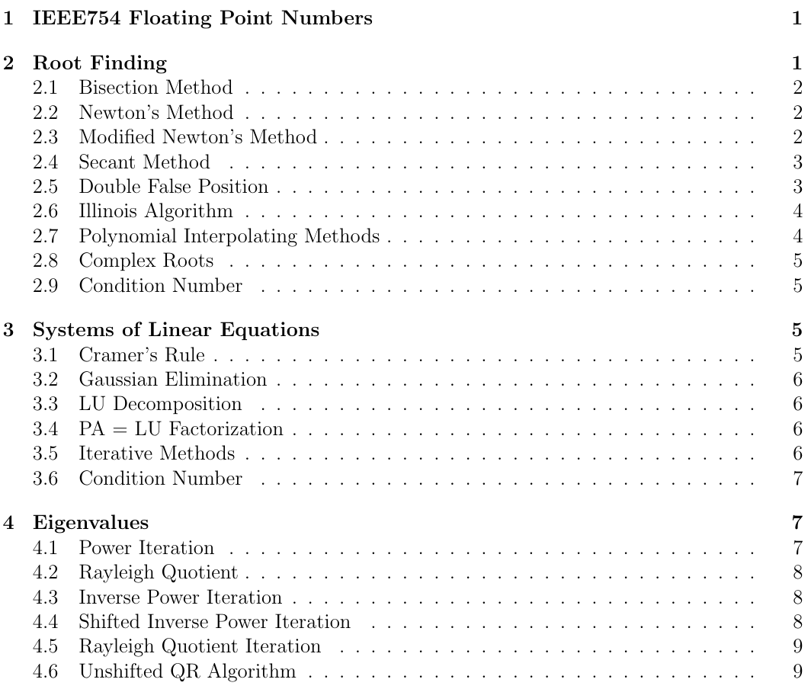

Slide 3
Interpolation 2: Error Analysis
AMSC/CMSC 460
Dr. Christopher Moakler

Slide 4
Vandermonde Matrix
Another way we can find the interpolating polynomial is by transforming the question into a system of equations for which we have several methods of solving.
We want to find a polynomial of the form,
$Q\left(x\right)=b_{0}+b_{1}x^{1}+b_{2}x^{2}+b_{3}x^{3}+…+b_{n}x^{n}$
We know the value of the function at n different points, so we can form the system of equations:
$\left[\begin{matrix}1 & x_{0} & ⋯ & x_{0}^{n} \\ 1 & x_{1} & ⋯ & x_{1}^{n} \\ ⋮ & ⋮ & ⋱ & ⋮ \\ 1 & x_{n} & ⋯ & x_{n}^{n}\end{matrix}\right]\left[\begin{matrix}b_{0} \\ b_{1} \\ ⋮ \\ b_{n}\end{matrix}\right]=\left[\begin{matrix}f(x_{0}) \\ f\left(x_{1}\right) \\ ⋮ \\ f(x_{n})\end{matrix}\right]$
Vandermonde Matrix

Slide 5
Vandermonde Determinant
This system of equations has a unique solution if the determinant is non-zero.
This determinant is known as the Vandermonde Determinant
This determinant is nonzero if the $x_{i}^{′}s$ are unique.
$\left|\begin{matrix}1 & x_{0} & ⋯ & x_{0}^{n} \\ 1 & x_{1} & ⋯ & x_{1}^{n} \\ ⋮ & ⋮ & ⋱ & ⋮ \\ 1 & x_{n} & ⋯ & x_{n}^{n}\end{matrix}\right|≠0$
You can find proofs on Wikipedia or in Sauer.

Slide 6
Polynomial Interpolation Example 1
Using the Lagrange Interpolation Formula to find an approximating polynomial of degree 1 for the function $f(x) = sin\left(x\right)$ using the points $x_{i}=0 and \frac{π}{2}$.
The first step is to find the values at the sample points.
$f\left(0\right)= sin\left(0\right)=0$
$f\left(\frac{π}{2}\right)= sin\left(\frac{π}{2}\right)=1$
Now we form the $L_{k}$ polynomials:
$L_{1}=\frac{(x−x_{2})}{(x_{1}−x_{2})}$
$L_{2}=\frac{(x−x_{1})}{(x_{2}−x_{1})}$
Let’s plug in our data points:
$L_{1}=\frac{(x−\frac{π}{2})}{(0−\frac{π}{2})}=−\frac{2}{π}x+1$
$L_{2}=\frac{(x−0)}{(\frac{π}{2}−0)}=\frac{2}{π}x$

Slide 7
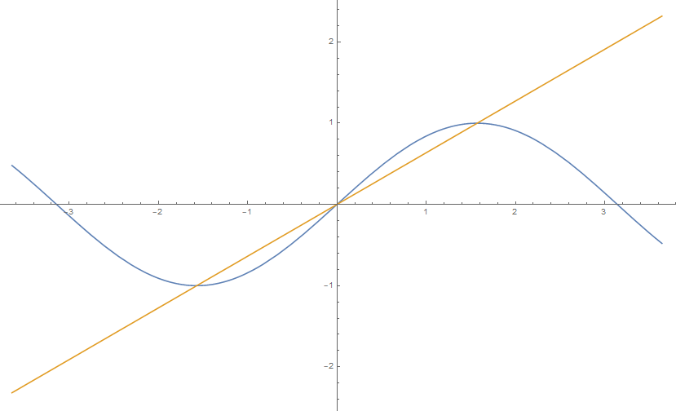
Polynomial Interpolation Example 1 cont
The full degree 1 polynomial is then:
$P_{1}=y_{1}L_{1}+y_{2}L_{2}=0∗\left(−\frac{2}{π}x+1\right)+1∗\frac{2}{π}x$
Simplifying gives:
$P_{1}\left(x\right)=\frac{2}{π}x$
The approximation is clearly not great.
Sauer

Slide 8
Polynomial Interpolation Example 2
Use the Lagrange Interpolation Formula to find an approximating polynomial of degree 3 for the function $f(x) = sin\left(x\right)$ using the points $x_{i}=0,\frac{π}{6},\frac{π}{3},and \frac{π}{2}$.
The first step is to find the values at the sample points.
$f\left(0\right)= sin\left(0\right)=0$
$f\left(\frac{π}{6}\right)= sin\left(\frac{π}{6}\right)=\frac{1}{2}$
$f\left(\frac{π}{3}\right)= sin\left(\frac{π}{3}\right)=\frac{\sqrt{3}}{2}$
$f\left(\frac{π}{2}\right)= sin\left(\frac{π}{2}\right)=1$

Slide 9
Polynomial Interpolation Example 2 cont
Now we form the $L_{k}$ polynomials:
$L_{1}=\frac{(x−x_{2})(x−x_{3})(x−x_{4})}{(x_{1}−x_{2})(x_{1}−x_{3})(x_{1}−x_{4})}$
$L_{2}=\frac{(x−x_{1})(x−x_{3})(x−x_{4})}{(x_{2}−x_{1})(x_{2}−x_{3})(x_{2}−x_{4})}$
$L_{3}=\frac{(x−x_{1})(x−x_{2})(x−x_{4})}{(x_{3}−x_{1})(x_{3}−x_{2})(x_{3}−x_{4})}$
$L_{4}=\frac{(x−x_{1})(x−x_{2})(x−x_{3})}{(x_{4}−x_{1})(x_{4}−x_{2})(x_{4}−x_{3})}$

Slide 10
Polynomial Interpolation Example 2 cont
Let’s plug in our data points:
$L_{1}=\frac{(x−\frac{π}{6})(x−\frac{π}{3})(x−\frac{π}{2})}{(0−\frac{π}{6})(0−\frac{π}{3})(0−\frac{π}{2})}$
$L_{2}=\frac{(x−0)(x−\frac{π}{3})(x−\frac{π}{2})}{(\frac{π}{6}−0)(\frac{π}{6}−\frac{π}{3})(\frac{π}{6}−\frac{π}{2})}$
$L_{3}=\frac{(x−0)(x−\frac{π}{6})(x−\frac{π}{2})}{(\frac{π}{3}−0)(\frac{π}{3}−\frac{π}{6})(\frac{π}{3}−\frac{π}{2})}$
$L_{4}=\frac{(x−0)(x−\frac{π}{6})(x−\frac{π}{3})}{(\frac{π}{2}−0)(\frac{π}{2}−\frac{π}{6})(\frac{π}{2}−\frac{π}{3})}$

Slide 11
Polynomial Interpolation Example 2 cont
You can continue on with this procedure, but I’m going to stop here.
This method is very straightforward to implement.
It does require a large amount of computation however.
We form multiple degree n-1 polynomials that can cause a lot of computer precision issues.
We also were not able to reuse any of the work that we did in the degree 1 polynomial case.
Let’s move on to using the Newton’s Difference Method.

Slide 12
Polynomial Interpolation Example 3
Using the Newton’s Difference Formula to find an approximating polynomial of degree 1 for the function $f(x) = sin\left(x\right)$ using the points $x_{i}=0 and \frac{π}{2}$.
We first need to find the differences so let’s form the table
x | sin(x) | 1st DD
0 | 0
$$\frac{π}{2}$$ | 1 | $$\frac{2}{π}$$

Slide 13
Polynomial Interpolation Example 3 cont
Newton’s Divided Difference formula tells us:
$P\left(x\right)=f\left[x_{1}\right]+f[x_{1},x_{2}](x−x_{1})$ $+f\left[x_{1},x_{2},x_{3}\right]\left(x−x_{1}\right)\left(x−x_{2}\right)+…$
We only need the first two terms:
$P\left(x\right)=0+\frac{2}{π}\left(x−0\right)=\frac{2}{π}x$
This way is pretty straightforward, right?

Slide 14
Polynomial Interpolation Example 4
Using the Newton’s Difference Formula to find an approximating polynomial of degree 3 for the function $f(x) = sin\left(x\right)$ using the points $x_{i}=0,\frac{π}{6},\frac{π}{3},and \frac{π}{2}$.
We first need to find the differences so let’s form the table:
x | sin(x) | 1st DD | 2nd DD | 3rd DD
0 | 0
$$\frac{π}{6}$$ | $\frac{1}{2}$ | 0.9549
$$\frac{π}{3}$$ | $$\frac{\sqrt{3}}{2}$$ | 0.6990 | -0.2443
$$\frac{π}{2}$$ | 1 | 0.2559 | -0.4232 | -0.1139

Slide 15
Polynomial Interpolation Example 4 cont
Newton’s Divided Difference formula tells us:
$P\left(x\right)=f\left[x_{1}\right]+f[x_{1},x_{2}](x−x_{1})$ $+f\left[x_{1},x_{2},x_{3}\right]\left(x−x_{1}\right)\left(x−x_{2}\right)+f\left[x_{1},x_{2},x_{3},x_{4}\right]\left(x−x_{1}\right)\left(x−x_{2}\right)\left(x−x_{3}\right)$
Plugging in the DDs
$P\left(x\right)=0+\text{0.9549}\text{∗}\left(x−x_{1}\right)−\text{0.2443}∗\left(x−0\right)\left(x−\frac{π}{6}\right)−\text{0.1139}∗\left(x−0\right)\left(x−\frac{π}{6}\right)\left(x−\frac{π}{3}\right)$
Putting this in the nested form can gain us some efficiency
$P\left(x\right)=x\text{(}\text{0.9549}+\left(x−\frac{π}{6}\right)(−\text{0.2443}\text{+(}x−\frac{π}{3})(−\text{0.1139}\text{))) }$
We have converted the sine function into a polynomial with 6 coefficient/points that requires only 3 adds and 3 multiplies to compute.
How good is it?

Slide 16
Polynomial Interpolation Example 4 cont
Sauer

Slide 17
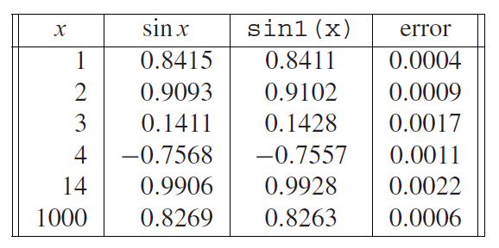
Polynomial Interpolation Example 4 cont
Pretty good!
Sauer

Slide 18
Interpolation Error
How good is pretty good here?
In general, can we determine how good our approximation will be?
We can put a pretty good bound on the error using the Interpolation Error Formula,
$f\left(x\right)−P_{n}\left(x\right)= \frac{\left(x−x_{0}\right)\left(x−x_{2}\right)…\left(x−x_{n}\right)}{(n+1)!}f^{\left(n+1\right)}\left(ξ\right)$.
Here $ξ$ is between $x_{0}<ξ<x_{n}$.
From our problem from before, we have,
$\sin\left(x\right)−P_{3}\left(x\right)= \frac{\left(x−0\right)\left(x−\frac{π}{6}\right)\left(x−\frac{π}{3}\right)\left(x−\frac{π}{2}\right)}{4!}f^{\left(4\right)}\left(ξ\right)$
What is the largest our error can be?

Slide 19
Interpolation Error Example 1
From our problem from before, we have,
$\sin\left(x\right)−P\left(x\right)= \frac{\left(x−0\right)\left(x−\frac{π}{6}\right)\left(x−\frac{π}{3}\right)\left(x−\frac{π}{2}\right)}{4!}f^{\left(4\right)}\left(ξ\right)$
$\sin\left(x\right)−P\left(x\right)=\frac{\left(x−0\right)\left(x−\frac{π}{6}\right)\left(x−\frac{π}{3}\right)\left(x−\frac{π}{2}\right)}{24}\sin\left(ξ\right)$
What is the largest our error can be?
Well, where is $\sin\left(ξ\right)$ the largest?
Clearly it can not be larger than 1.
We can bound the error as,
$\left|\sin\left(x\right)−P\left(x\right)\right|≤\frac{\left|\left(x−0\right)\left(x−\frac{π}{6}\right)\left(x−\frac{π}{3}\right)\left(x−\frac{π}{2}\right)\right|}{24}$
At the point $x=1$, the error is bounded by,
$\left|\sin\left(1\right)−P\left(1\right)\right|≤\frac{\left(1−0\right)\left(1−\frac{π}{6}\right)\left(1−\frac{π}{3}\right)\left(1−\frac{π}{2}\right)}{24}≈0.00005348$

Slide 20
Interpolation Error Example 2
Find an upper bound for the error at the points $x=0.25 and 0.75$of the interpolating polynomial that approximates $f\left(x\right)=e^{x}$ using the points $x=−1, −0.5, 0, 0.5, 1$
What’s our first step?
We do NOT need to actually construct the polynomial to apply the theorem!
$f\left(x\right)−P_{n}\left(x\right)= \frac{\left(x−x_{1}\right)\left(x−x_{2}\right)…\left(x−x_{n}\right)}{(n+1)!}f^{\left(n+1\right)}\left(ξ\right)$.
For this example, the error is,
$f\left(x\right)−P_{4}\left(x\right)= \frac{\left(x+1\right)\left(x+0.5\right)(x)(x−0.5)(x−1) }{5!}f^{\left(5\right)}\left(ξ\right)$
The fifth derivative is obvious,
$f\left(x\right)−P_{4}\left(x\right)= \frac{\left(x+1\right)\left(x+0.5\right)\left(x\right)\left(x−0.5\right)\left(x−1\right)}{5!}e^{ξ}$

Slide 21
Interpolation Error Example 2 cont
We need to know where,
$f\left(x\right)−P_{4}\left(x\right)= \frac{\left(x+1\right)\left(x+0.5\right)\left(x\right)\left(x−0.5\right)\left(x−1\right)}{5!}e^{ξ}$ is a maximum.
This occurs at the right end point, so the error becomes,
$\left|f\left(x\right)−P_{4}\left(x\right)\right|=\left| \frac{\left(x+1\right)\left(x+0.5\right)\left(x\right)\left(x−0.5\right)\left(x−1\right)}{5!}e\right|$
At $x=0.25$, we have,
$\left|f\left(0.25\right)−P_{4}\left(0.25\right)\right|=\left| \frac{\left(0.25+1\right)\left(0.25+0.5\right)\left(0.25\right)\left(0.25−0.5\right)\left(0.25−1\right)}{5!}e\right|≈0.000995$
At $x=0.75$, we have,
$\left|f\left(0.75\right)−P_{4}\left(0.75\right)\right|=\left| \frac{\left(0.75+1\right)\left(0.75+0.5\right)\left(0.75\right)\left(0.75−0.5\right)\left(0.75−1\right)}{5!}e\right|≈0.002323$

Slide 22
Interpolation Error cont
The interpolation error tends to be smaller the closer you are to the center of the interval you are approximating on.
As you get further from the center, the error can become particularly large.
This is exacerbated if you choose equally spaced sample points.
Polynomials prefer to take certain shapes over others.
The shape they prefer to take is quite a bit more “wiggly” than we may like.
This is known as the “Runge Phenomenon”

Slide 23
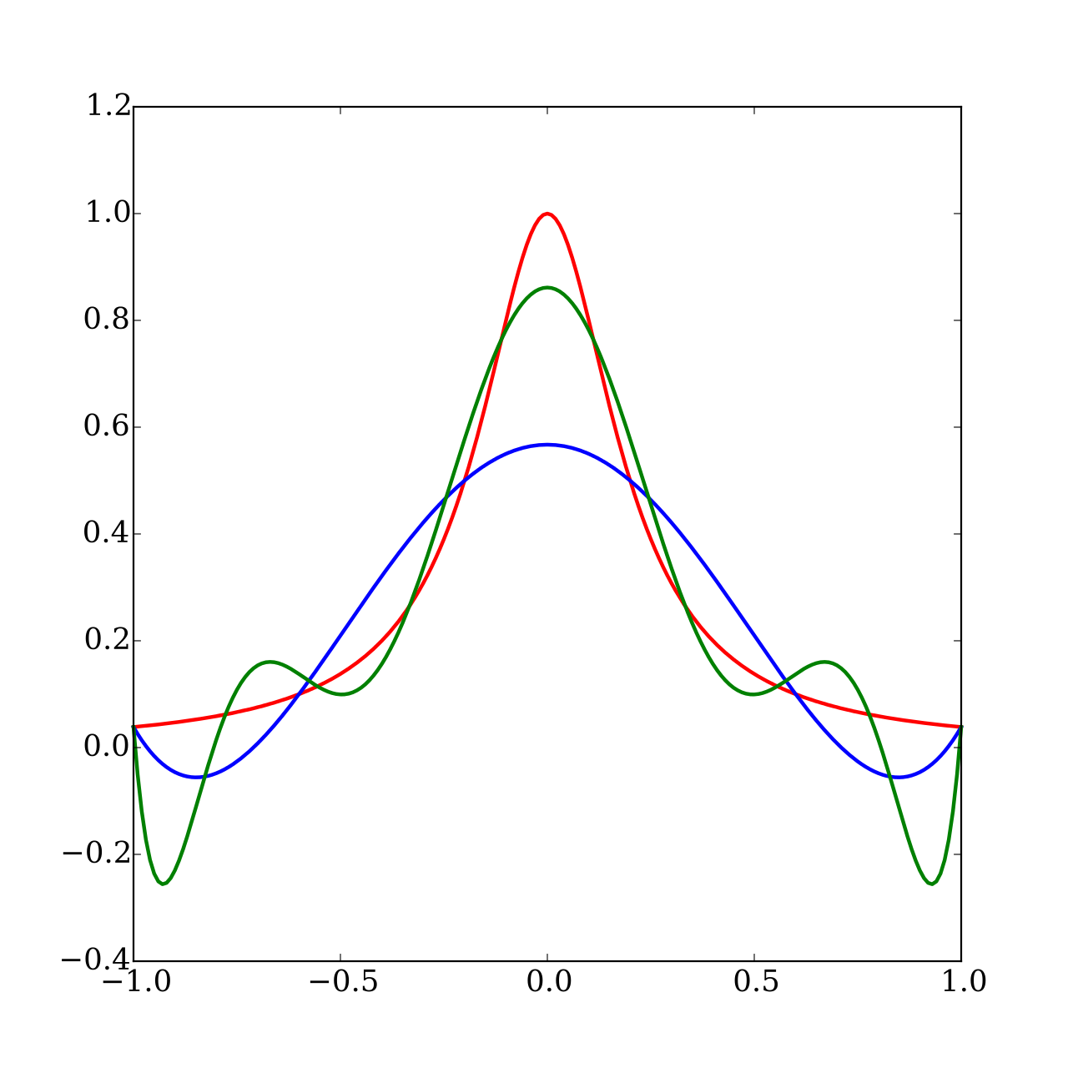
Runge Phenomenon
The red curve is the Runge Function:
$$f\left(x\right)=\frac{1}{1+25x^{2}}$$
Sauer
The blue curve is a 5th order interpolating polynomial with equally spaced points.
The green curve is a 9th order interpolating polynomial with equally spaced points.
https://en.wikipedia.org/wiki/Runge%27s_phenomenon#/media/File:Runge_phenomenon.svg

Slide 24
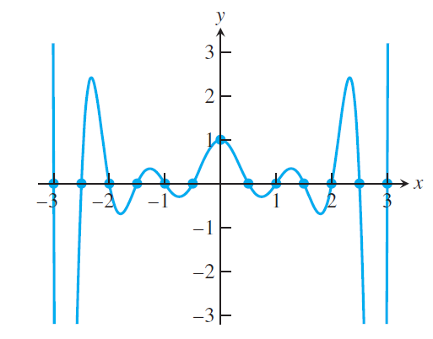
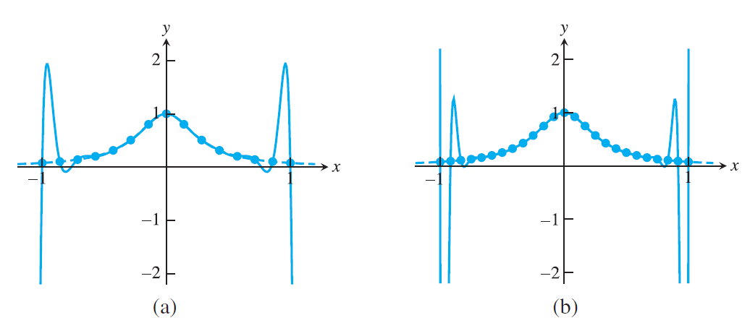
Runge Phenomenon cont
As you add more terms, the polynomial can get more and more wiggly.
Here’s an example from Sauer.
Sauer

Slide 25
Improving the error
If we are allowed to choose the sample points, we can pick them intelligently so that we minimize the error.
Say you are trying to approximate the temperature of a steel rod, you tell your experimentalist colleague to take data at certain values of $x$.
These points that minimize the interpolation error are known as Chebyshev Points.
Silly scientists often think it’s better to take equally spaced data and we are often stuck with it.
Silly scientists…
If we have to work with equally spaced data, what can we do?
Instead of interpolating a high order polynomial, we can instead interpolate lower degree polynomials on a subset of the data and then splice them together.
One way to do this is via cubic splines.

